Slide 1
Quest for Actionable Intelligence
TrueSight Capacity Optimization Documentation Options
Featuring the most powerful idea – EVER
“If I can do that, then I should be able to … “
Conversations about TSCO
Andrea Gallo – andrea.gallo@moviri.com
Notes:
This is a webinar conversation about the TrueSight Capacity Optimization Documentation Options.
Our goal is to show options for getting help with your TSCO environment, expand your tools and techniques, and to more effectively, efficiently, and purposefully pursue your Quest for Actionable Intelligence.
We go beyond the obvious TSCO documentation options and the BMC Communities page. Using the most powerful idea – EVER, “If I can do that, then I should be able to do… “ We step through finding a metric of interest ‘on the internet’ then investigating that metric in our environment, then incorporating that metric into our quest for Actionable Intelligence.
Come join Moviri for a fast paced adventure in our quest for Actionable Intelligence.

Slide 2
Agenda
Moviri
Documentation Options
  Obvious sources
  Less Obvious sources
If I can do THAT, I should be able to…. The most powerful idea…. Ever.
  Start simple within TSCO
  Example of applying a blog entry
Questions??
Comments and links in the notes section of the presentation.
Notes:
Agenda
Quick introduction to us, Moviri.com
Pointing to documentation options for BMC TSCO, then finding less obvious sources.
If I can do THAT, then I should be able to… this is the most powerful idea,… EVER.
We will put that to the test, by reviewing a simple example in TSCO then by using an example of finding some document that has an interesting observation and metric, that we then apply to our quest for actionable intelligence in TSCO.
Then will end with a summary and opportunity for questions.

Slide 3




Why Listen To Us
Movìri is a global IT consultancy with multiple offices in the US and around the globe
More than 200 engineers worldwide
  More Doctors than most hospitals ☺
Developers of Caplan, become BMC TrueSight Capacity Optimization
Movìri has several lines of business:
  Testing & Optimization
  Monitoring
  Operations and Cloud
  Security, Analytics
  Capacity Management
Big picture, many disciplines, much experience
  ContentWise.com; Cleafy.com; AKAMAS.IO
We can help you do this quickly and cleanly
Notes:
So why listen to Moviri?
Movìri is a global IT consultancy with multiple offices in the US and around the globe
More than 200 engineers world wide we have more Doctors than most hospitals!
Started as Neptuny, developers of Caplan, a magic quadrant capacity optimization product. Purchased by BMC in 2010 to become BMC Capacity Optimization, which is now BMC TrueSight Capacity Optimization. Neptuny became Movìri.
Movìri has several lines of business, including Testing & Optimization, Monitoring. Operations and Cloud, Security, Analytics, and Capacity Management – which is to say we think holistically. Big picture, many driplines, much experience, and continue to offer innovative products, including ContentWise; Cleafy; AKAMAS
Movìri has been doing this a long time, and is a thought leader and innovator.
And most importantly, you should listen to Movìri because: We can help you do this – quickly, and cleanly.
So, Let us jump right in…
===
https://www.crunchbase.com/organization/neptuny
http://www.moviri.com/2010/10/goodbye-neptuny-welcome-moviri/
https://www.moviri.com/news-events/akamas-ai-powered-performance-optimization-solution/
https://www.moviri.com/
https://www.akamas.io/
https://www.contentwise.tv/
https://www.cleafy.com/
https://www.linkedin.com/company/moviri/about/

Slide 4
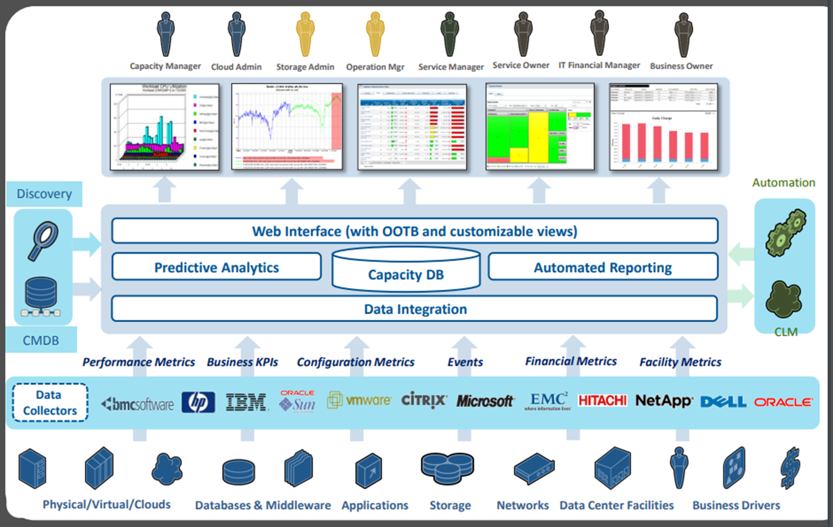
Actionable Intelligence
Notes:
Documentation Options
Obvious documentation sources are the TSCO site and BMC Communities.
https://docs.bmc.com/docs/TSCapacity/110/home-674154108.html
https://docs.bmc.com/docs/btco113/home-775471452.html
https://docs.bmc.com/docs/capacityoptimization/btco115/home-830156123.html
https://communities.bmc.com/community/bmcdn/capacity_management
While you might think the only option is to read the four thousand page TSCO document, and maybe the TSCO Communities pages, but there far more creative options. Yes you should read the TSCO and BMC documents for how the tools, features, and functions work, but putting these together in novel ways takes some creativity.
Actually it takes an interesting question and some trial and error to answer the questions.
Don’t overlook the documentation and user communities of the venders that potentially have (can contribute) data in TSCO. VMWare, IBM, Oracle and the other vendors have conversations about capacity optimization, monitoring, troubleshooting etc. Essentially the last two rows in the graphic. These sources can be adapted to be used in TSCO.
Debby Sheetz
ftp://ftp.bmc.com/pub/perform/gfc/das/

Slide 5
Gather and USE Data
Service data
# of web hits
API Resp.times
# of transactions
# of users
Service-to-resource relationships
Service changes
Platforms
Infrastructure capacity
Middleware
IT metrics
Applications
Visibility
Service Level view
Services
Cost transparency
Infrastructure
Service Maps
Re-claim & right-size
ITSM
Service
Events (incidents)
Capacity Management
Financial data
IT costs
Cost rates Ownerships
Licensing
Cost Saving
Optimize changes
Financial
Facilities
Non IT
metrics
Cost-driven optimization
IT strategy
+ plans
Demand
Find capacity shortages
Business strategy +plans
Risk Reduction
Align
business
Financial Data
ITFM
Notes:
Don’t be intimidated with the whole. Start ‘small’. Small does not mean insignificant. Small means focused. How do we do that?
Lets ignore financial
*
Ignore Services
*
And some of the infrastructure we do not wish to look at for the moment
*
This leaves us with IT Metrics and Visibility.
More specifically Visibility of infrastructure capacity by way of IT Metrics, specifically platform and Middleware data

Slide 6
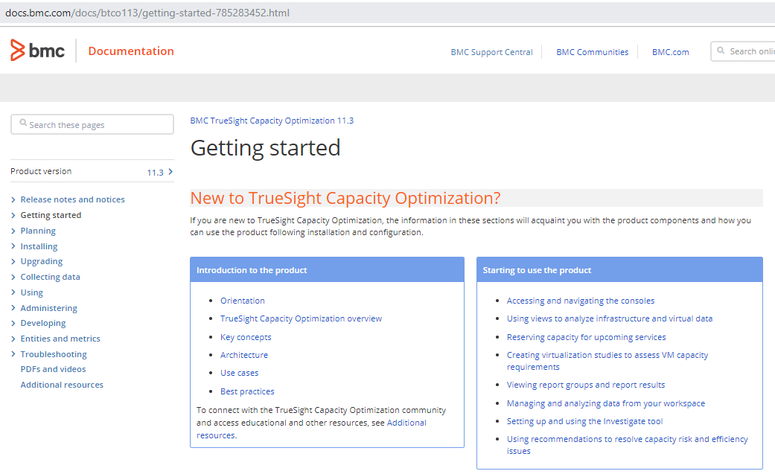
Pick A Metric (Data Source)
Notes:
The first metric assumes a bunch of work is already done:
Monitoring data already available
Install equipment for TSCO
Install software for TSCO
Configure TSCO
We see the documentation for TSCO steps through this with introductions to the architecture, use cases, and best practices.
BMC Professional services can streamline this as the documentation covers a number of use cases and it is easy to get distracted if your use case is not clear in the beginning.
The AMIGO program may help as well
https://docs.bmc.com/docs/btco113/amigo-upgrade-assistance-program-for-truesight-capacity-optimization-775471640.html?src=search
And a Knowledge Article
https://bmcsites.force.com/casemgmt/sc_KnowledgeArticle?sfdcid=000141384
With everything installed… Pick a metric… CPU
Where is the data? Configure an ETL.
https://docs.bmc.com/docs/btco113/out-of-the-box-etls-775471787.html
Lets assume VMWare..
https://docs.bmc.com/docs/btco113/vmware-vcenter-extractor-service-775471947.html
Notice that link has a short YouTube video.

Slide 7
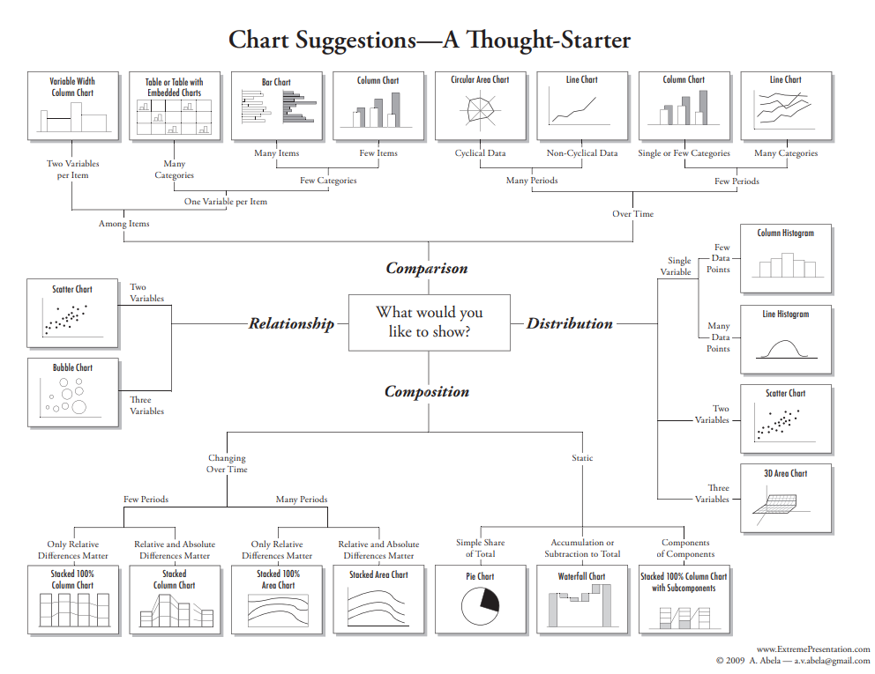
Choose A Mission (Chart)
Notes:
Pick a Mission… Historical trend such that a forecast can be done, which leads to Top-N (and Bot-N) analysis, and to anomaly detection.
Choose a chart
What story do you wish to tell?
Which thesis do you wish to prove (or disprove)?
Historical trend means a Comparison | Over Time | Many Periods | Non-Cyclical Data = Line Chart
Docs for charting, forecasting
https://www.edwardtufte.com/tufte/
=====
https://eazybi.com/blog/data_analysis_and_visualization/
Actionable Intelligence Lifecycle and the Conscious Use Of Conceptual Models
http://mlcu.com/ActionableIntelligenceLifecycle201811b.pptx
www.ExtrenePresentation.com

Slide 8
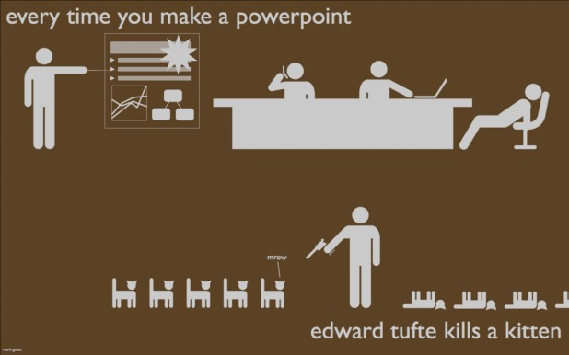

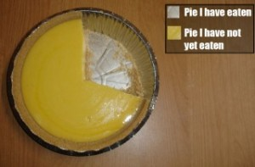
Choose Wisely
Notes:
Choosing an appropriate visual representation of the data to convey the ‘story’ of the numbers is important, difficult and fraught with abuse.
https://visual.ly/blog/making-it-funny-8-hilarious-infographics/

Slide 9
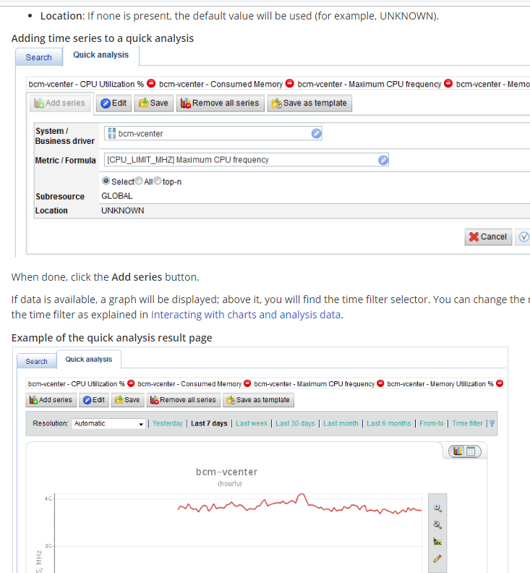
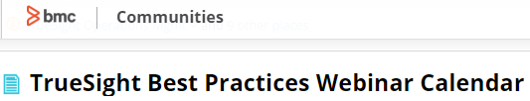
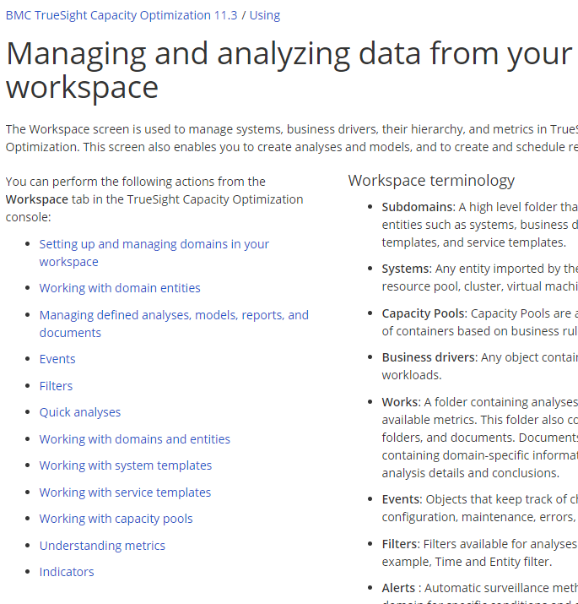
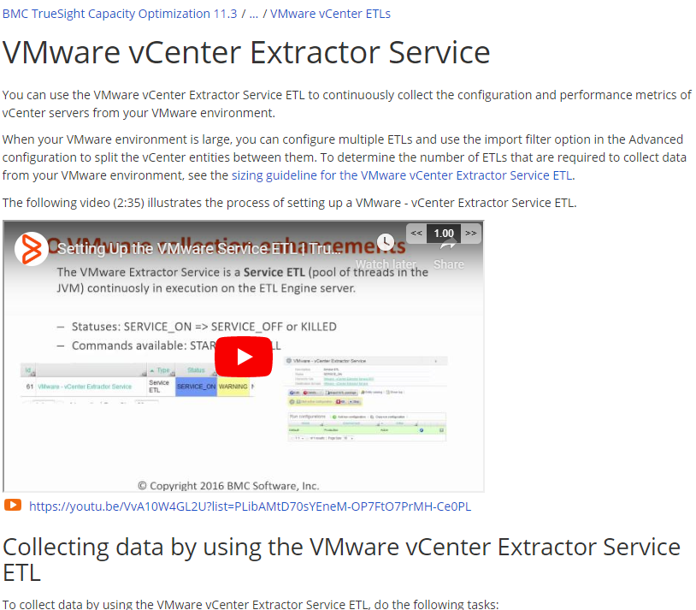
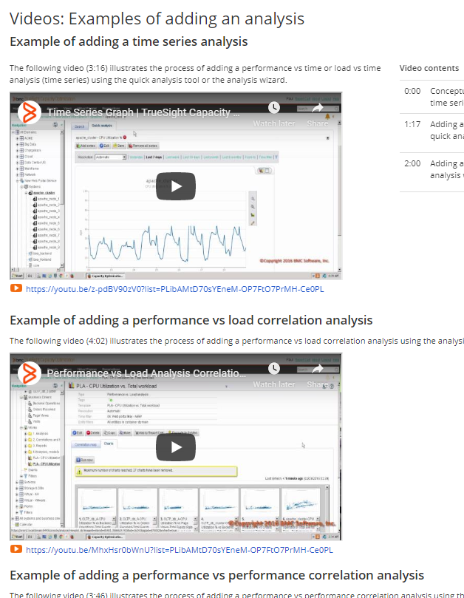
Data Source to Chart – TSCO Docs
Notes:
Identify the data source = VMWare
Setup ETL https://docs.bmc.com/docs/btco113/vmware-vcenter-extractor-service-775471947.html
Managing and analyzing data from your workspace
https://docs.bmc.com/docs/btco113/managing-and-analyzing-data-from-your-workspace-775472446.html
Quick Analysis https://docs.bmc.com/docs/btco113/quick-analyses-775472707.html?src=search
Creating an analysis https://docs.bmc.com/docs/btco113/creating-an-analysis-775472517.html
Of particular interest is a BMC program that is showing examples of putting tools and techniques together. Well worth a through review.
TrueSight Best Practices Webinar Calendar
https://communities.bmc.com/docs/DOC-107967

Slide 10
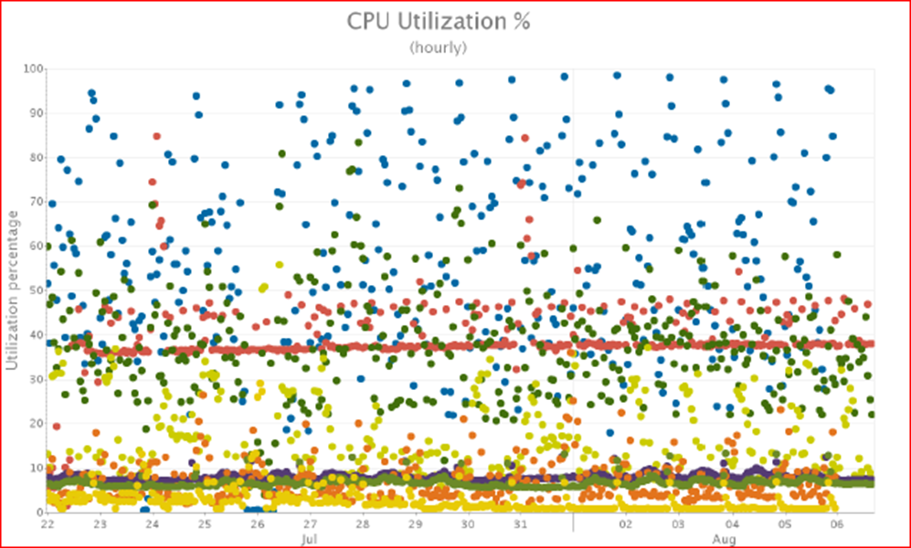
Alternate Docs
Writing the Capacity Report with HCSC
 | Presented at Engage2016 BMC Global User Conference - September 2016. Writing a quality capacity report that all stake holders can use is not as easy as people think. Come to this session to walk through the following key areas: The elements of the capacity report Metrics vs. volumes Threshold analysis Trend reporting Problem recognition The executive summary
tsco "capacity optimization" -inurl:bmc.com -inurl:bmcsoftware
Notes:
There are a number of alternate docs. I have several on my web site. And there are a number of sites about capacity planning, data analysis, charting techniques etc.
This is an example chart from a presentation we made at BMC Engage2016
tsco "capacity optimization" -inurl:bmc.com -inurl:bmcsoftware Will deliver about a thousand results. Many from Moviri, YouTube, and MLCU.com
The point is that there are other sources for documentation.
=====
Writing the Capacity Report with HCSC
http://mlcu.com/679WritingCapacityReport.pptx

Slide 11

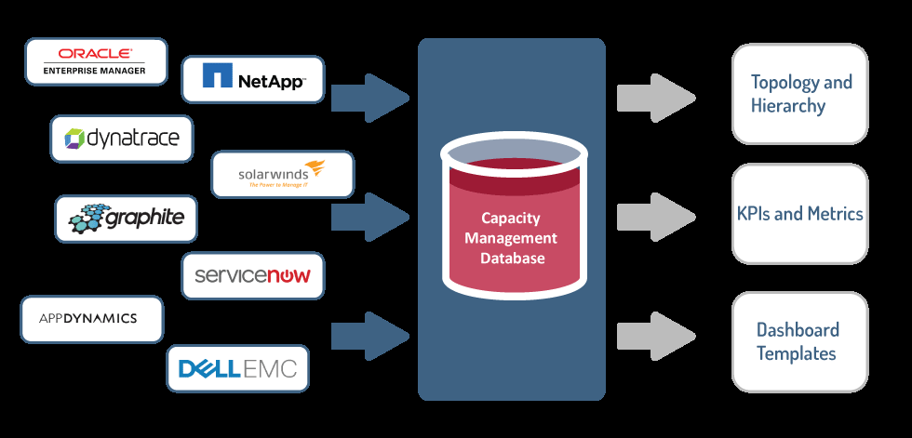
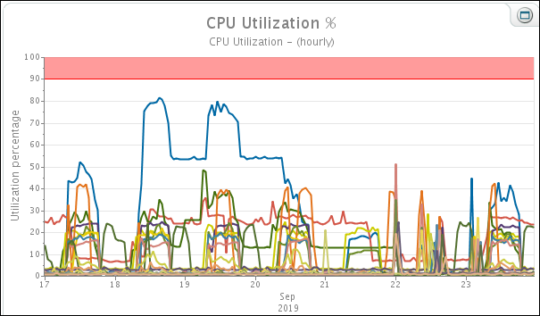
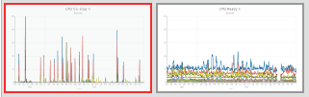
If I can do THAT
ETL
TSCO
CPU
(MEM
Disk
Network)
Then I can…
ETL
TSCO
Co-Stop
Ready
The most powerful idea… EVER!
Notes:
If I can do THAT, I should be able to…. The most powerful idea…. Ever.
What this suggests is that you have used the documentation to isolate a metric CPU and are able to chart it in various useful ways.
“If I can do THAT, then I can…. “ find a different metric and use the same sort of process to chart that…
In that case you were talking to a trusted partner (for the record that would be Moviri) and CPU Co Stop and CPU Ready were presented as useful metrics to track….

Slide 12
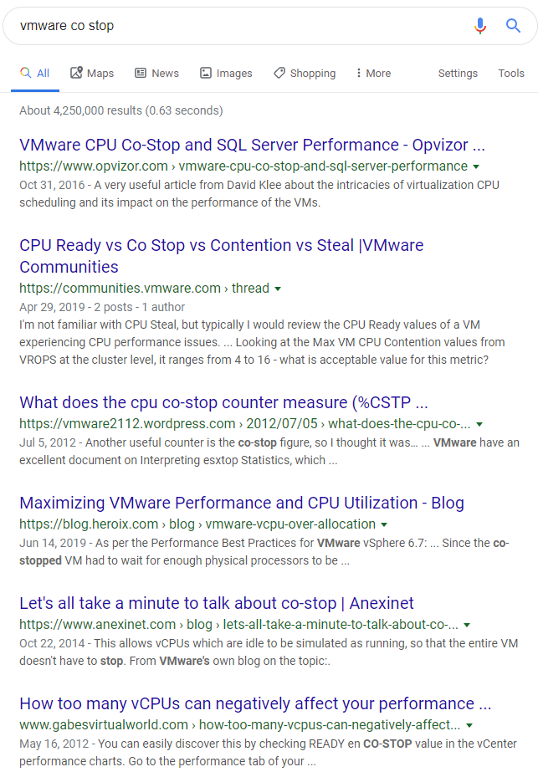
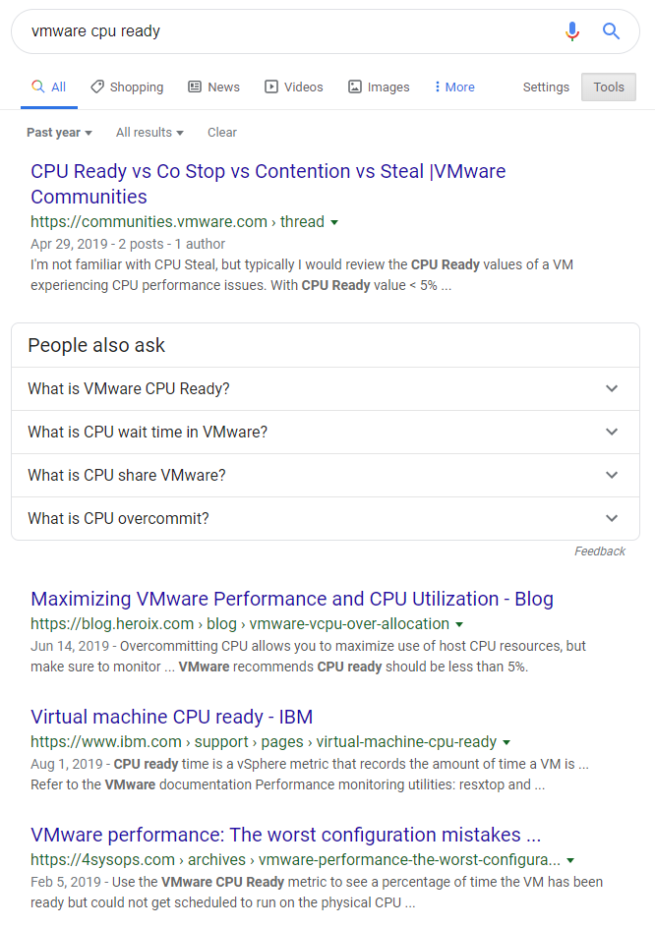
VMWare Co-Stop
VMWare CPU ready
Notes:
So your trusted partner suggested (or wherever you got the idea to look), so you make an internet search..
Interesting results for both metrics. The last one on each list seems a bit ominous… Maybe you really should be looking at these metrics.
“How too many vCPUs can negatively affect your performance…” and “VMware Performance: The worst configuration mistakes…”
You read up on these metrics and adapt what you find into making a chart or two.

Slide 13
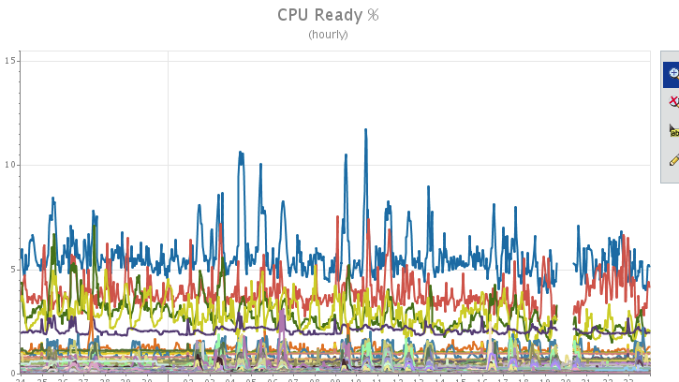
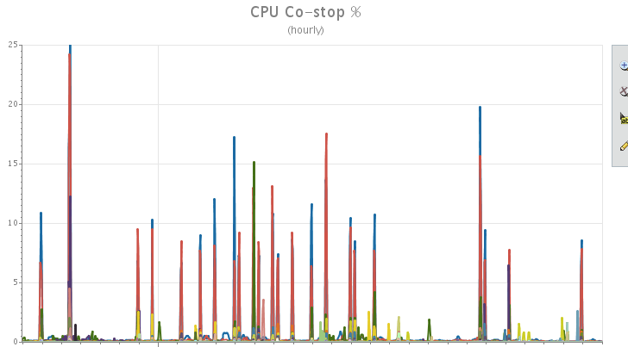
Results for CPU Co-stop and CPU Ready
Notes:
We see that the metrics are available – or we know that the monitoring tool needs to be set to collect the metrics AND the ETL needs to be set to get the metrics.
Our DOCUMENTATION will help us figure that out.
Out charts show ‘low numbers’ but how do we know what is ‘good’ or ‘normal’. Documentation. Reviewing the vender docs, support communities, technical papers, and talking to local experts helps you know what is important, how to interpret it, and how to monitor it.
Then use the TSCO documentation, support communities, technical pagers and your local experts (at Moviri) to show how to display important data for action. Which is to say, enhance your tools and techniques in your quest for actionable intelligence.

Slide 14
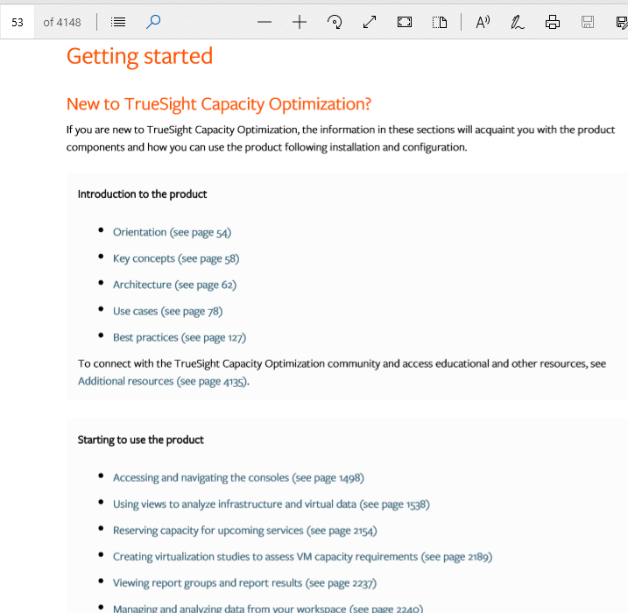
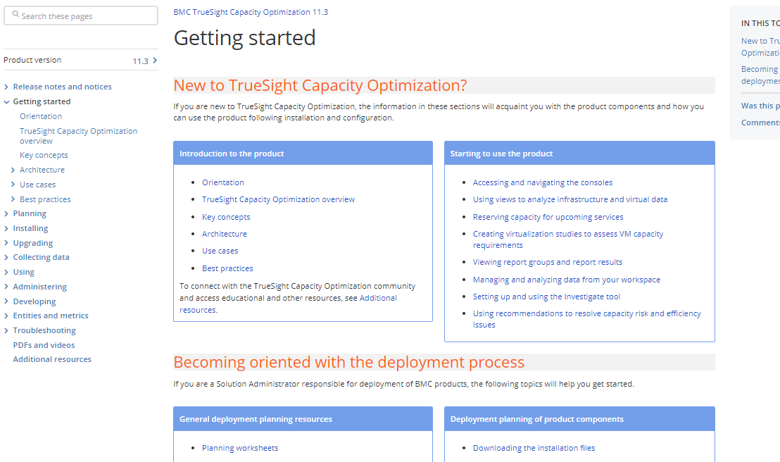
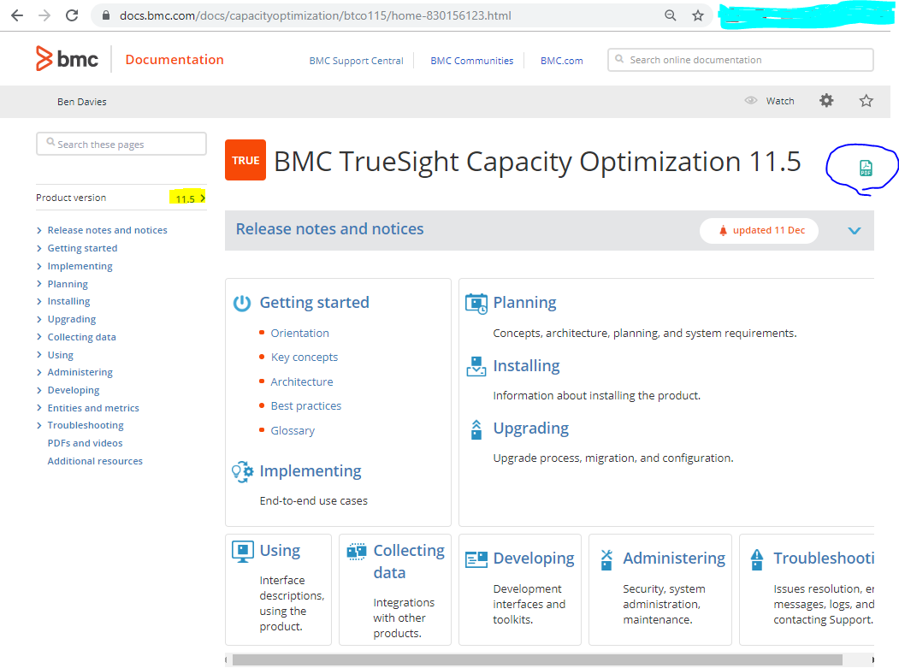
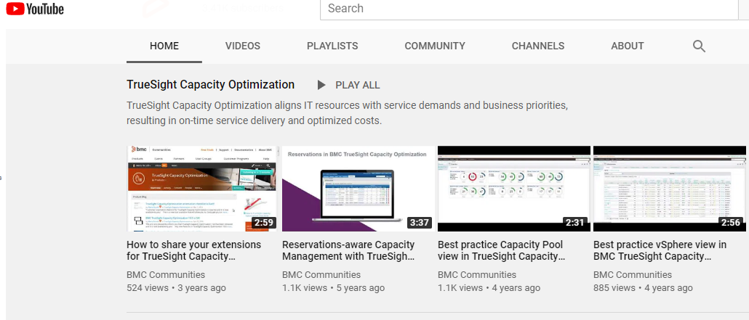
BMC TSCO online vs. PDF doc vs. YouTube
Notes:
We mentioned before but let us revisit the BMC official documentation.
I found YouTube for BMC TSCO. They are very short at 4 or less minutes and are very disappointing until you realize they are intended to be see in the context of the online documentation. That section of documentation goes into significant detail on the topic and the video quickly summarizes the topic on screen. What this suggests is that the YouTube should not be binge watched, but rather viewed within the expected context of the user document.
Then I found the four thousand page user document. I found that quite annoying as it would reference what to do next and went to the next paragraph. SO Silly. Then realized this was a re production of the online web site, where the what to do next actually goes to a separate web page. Once this is known it is far less annoying.
There are some that prefer the online documentation and some that prefer the PDF. It seems to me that you should use whatever is helpful to you. The online version is ‘most up to date’ while the PDF is easier to stumble on information, both refer to the YouTube videos.

Slide 15
Summary
There are obvious BMC documentation sources
There are less obvious documentation sources
  Both are very helpful and benefit when used together
If I can do THAT, I should be able to… The most powerful idea … Ever.
  Stringing tools and techniques together in various ways takes time and practice
  Start with something simple in TSCO and build to more interesting
  Start with applying a blog entry or other information and explore that in TSCO
Develop new tools and techniques for your
Quest for Actionable Intelligence
Notes:
In summary the intent is to show that there are many sources of documentation you can use in your Quest for Actionable Intelligence
Some are obvious and others are somewhat less obvious.
The ‘trick’ is to string tools and techniques together in various ways. Using the idea of “If I can do THAT, I should be ale to…” goes a long way to developing new tools and techniques for your Quest for Actionable Intelligence

Slide 16
Thank you for your attention.
Q & A Time
Documentation Options
Obvious sources - BMC.com, Communities
Less Obvious sources – Vendors, Moviri.com, MLCU.com
If I can do THAT, I should be able to…. The most powerful idea…. Ever.
Take what you know and apply it to something new.
Start small within TSCO
  Simple charts, simple metrics – small does not mean insignificant
Example of applying a blog entry – find new metrics, tools, techniques and apply those to TSCO
If I can plot CPU I can plot Memory
If I can plot machine metrics over time, I can trend machine metrics
If I can plot machine metrics, I can plot business metrics
If I can compare metrics to time, I can compare metrics to each other
If I can compare metrics to each other over time, I can forecast one vs a proposed change to the other
If I can predict business changes, I can predict hardware impacts and therefore costs
If I can determine hardware costs per business metrics, I can come up with Total Cost of Ownership and Return on Investment for a business strategy.
If I can xxx, then I can … to
∞

